Slide 1

Internet of Things
Innovating A Smarter Way Of Living
Presenter: Arpan Pal

Slide 2
Contents
Background of IoT
What is IoT?
Why do we need it?
Today’s world of Automation
Challenges
Conclusion

Slide 3
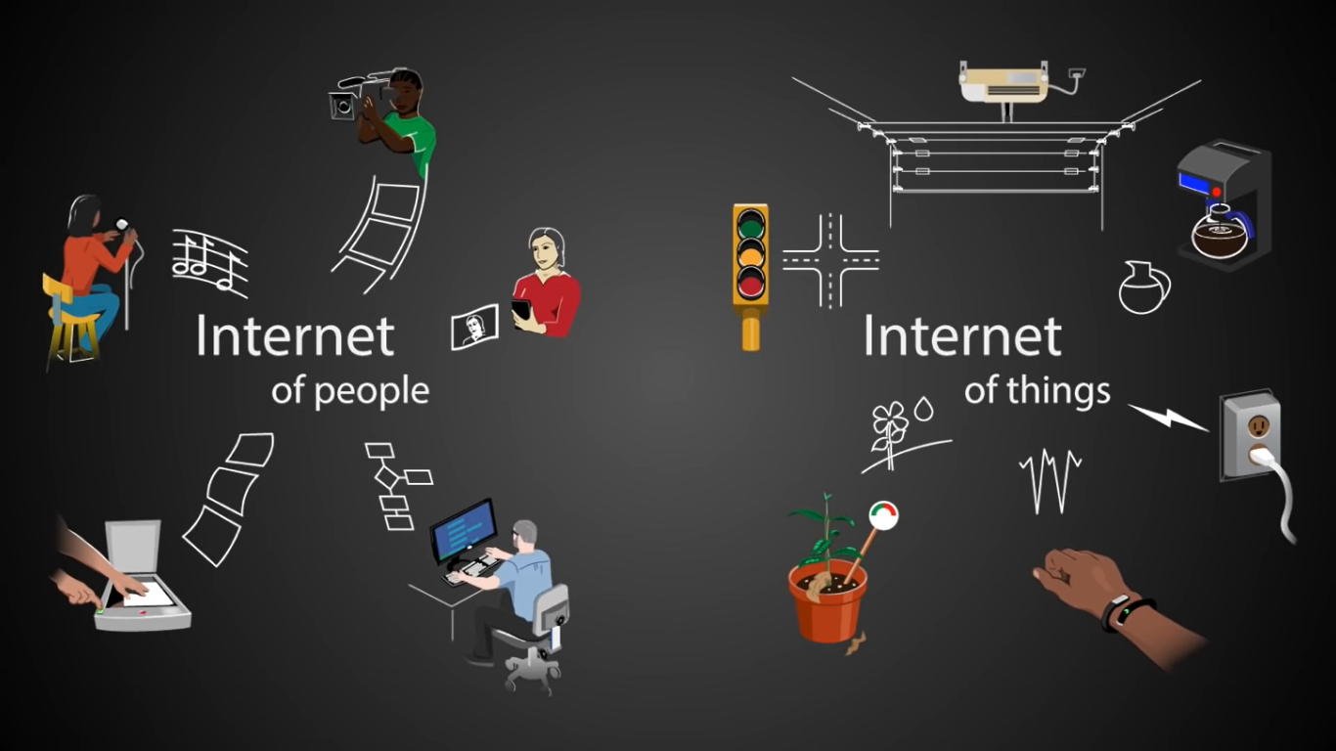

Slide 4


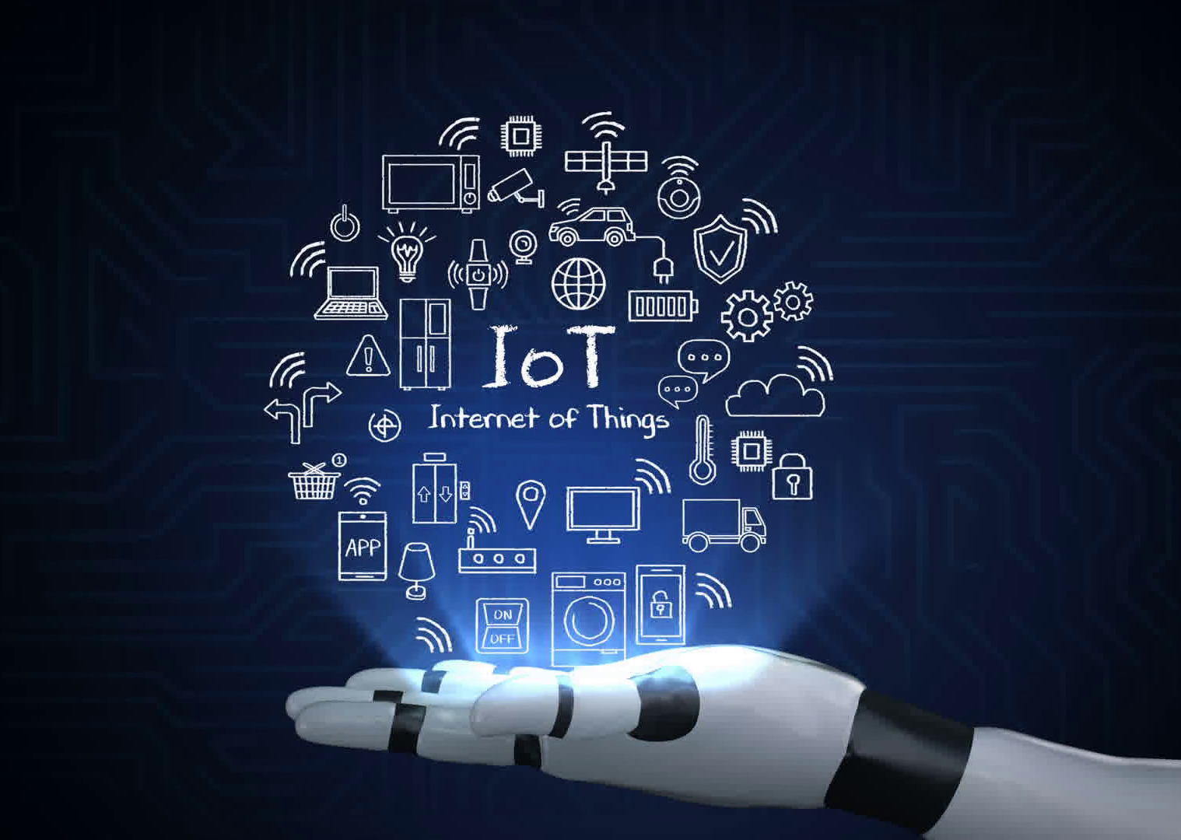
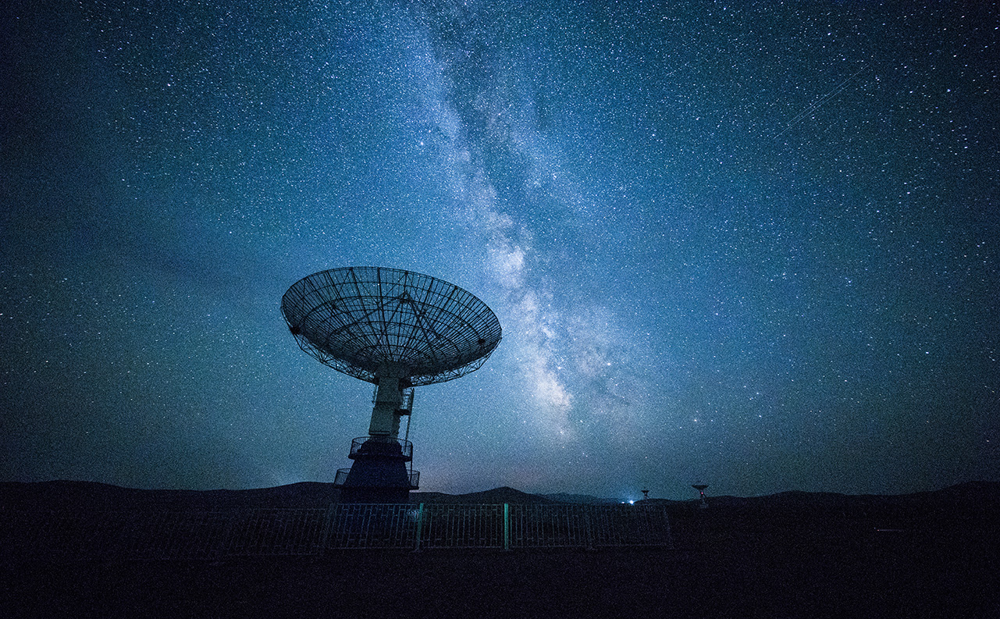
What is IoT?
Smart Products
Voice Recognition
Artificial Intelligence
Automation

Slide 5
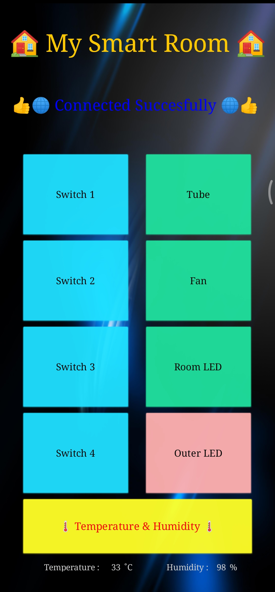
How many of you would love to
control your
ROOM APPLIANCES
from your phone?

Slide 6
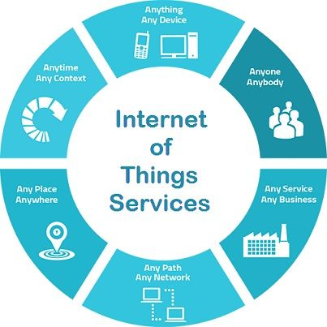
Why do we need IoT?
We are lazy
We want to AUTOMATE most of the things
We want to control everything REMOTELY

Slide 7
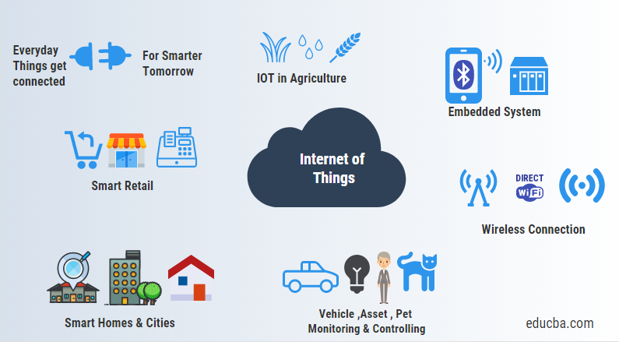
Today’s World of Automation
Connecting sensors to every objects around us.
Every device has it’s own unique ID in the network.
Communication among these smart devices reduces human intervention.

Slide 8
Challenges
Sensing a Complex Environment
Connectivity
Security
Power
Cloud Services

Slide 9
Conclusion
Internet of Things is the concept in which the virtual world of information technology connected to the real world of things
The goal behind the Internet of things is to have devices that self report in real-time.
Improving efficiency and bringing important information to the surface more quickly than a system depending on human intervention.
The technologies of Internet of things such as RFID and Sensor make our life become better and more comfortable.

Slide 10

Thank You!

